Slide 1
< Introduction to computational thinking – Mini project >
< au yi xian >
< Bachhas Nikita >
< Carissa Lee xue wei >

Slide 2
contributions
Member: | Contribution:
Carissa | Source Code: Import and read the text file, Design of the entry widget, Display the menu information, Operation hour, Waiting time
Nikita | Source Code: Design of the Menu page, User-defined date and time
Yi Xian | Source Code: stall_menu.txt, Design of the MainWindow (Root), Current date and time

Slide 3
THE FLOWCHART

Slide 4
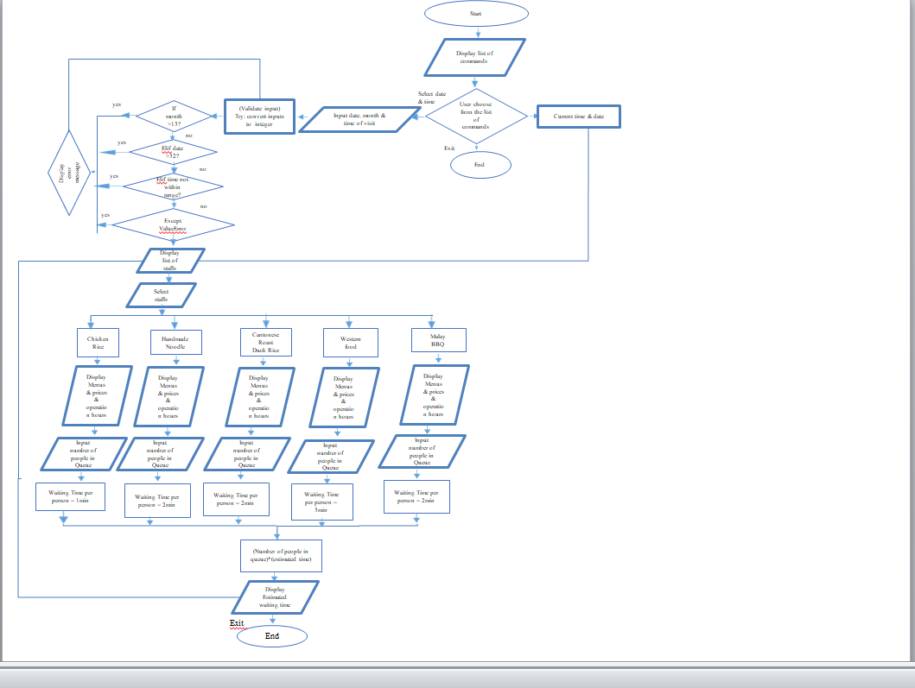

Slide 5
TIME FOR A DEMONSTRATION

Slide 6
Libraries & modules used
Tkinter
Txt file to store information
PIL
DateTime
Calendar

Slide 7
THE CODE

Slide 8
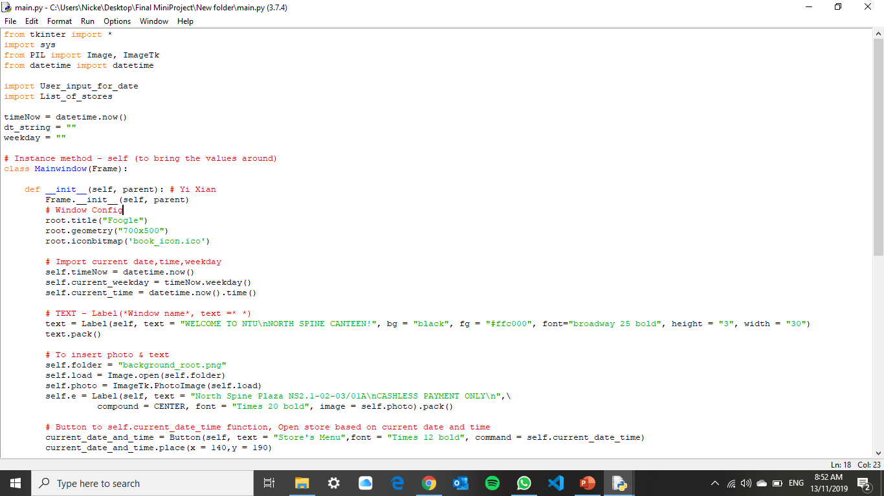

Creating the gui

Slide 9
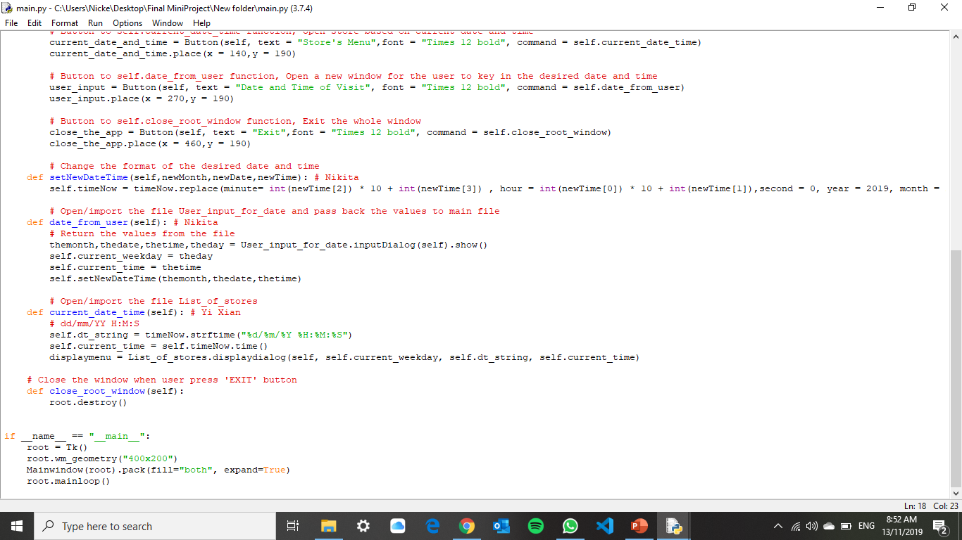
SETTING CURRENT DATE & TIME

Slide 10
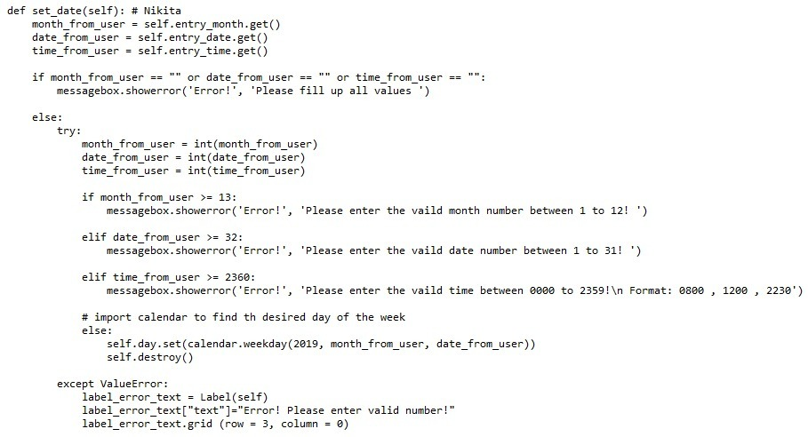
Using user-defined date & time

Slide 11
Replacing current date & time with desired date & time

Slide 12
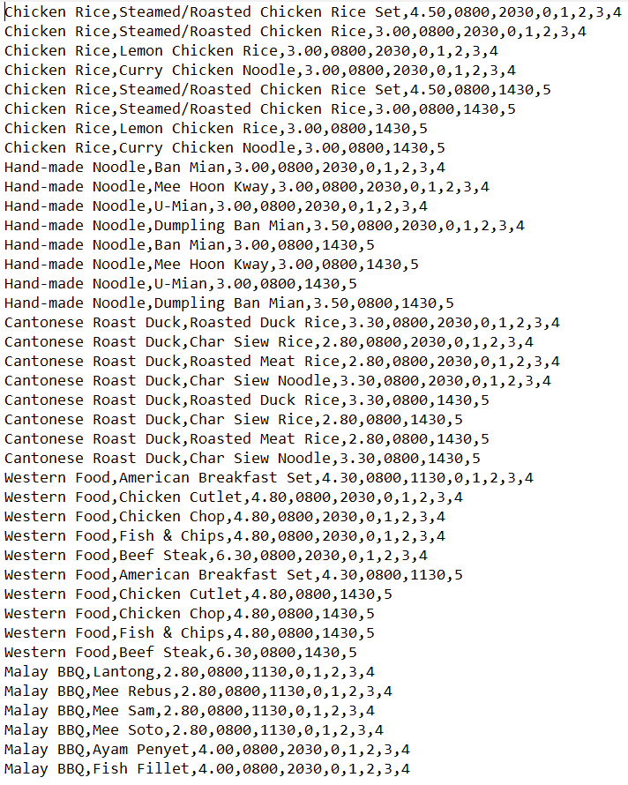
Store and display stall information/menu
Using a txt file to store all the stall information

Slide 13
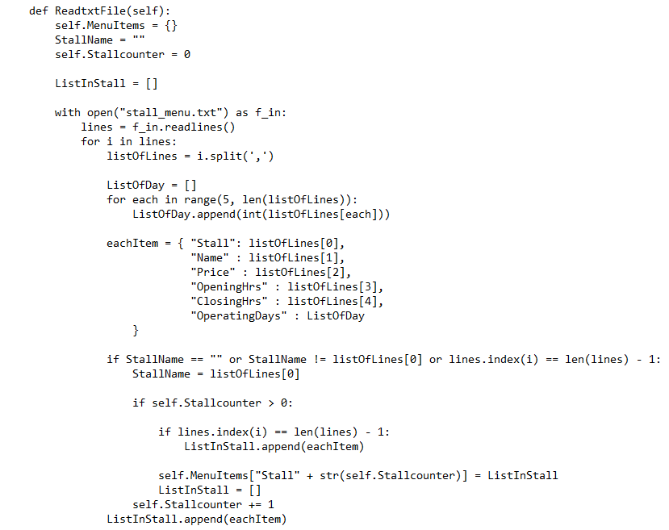
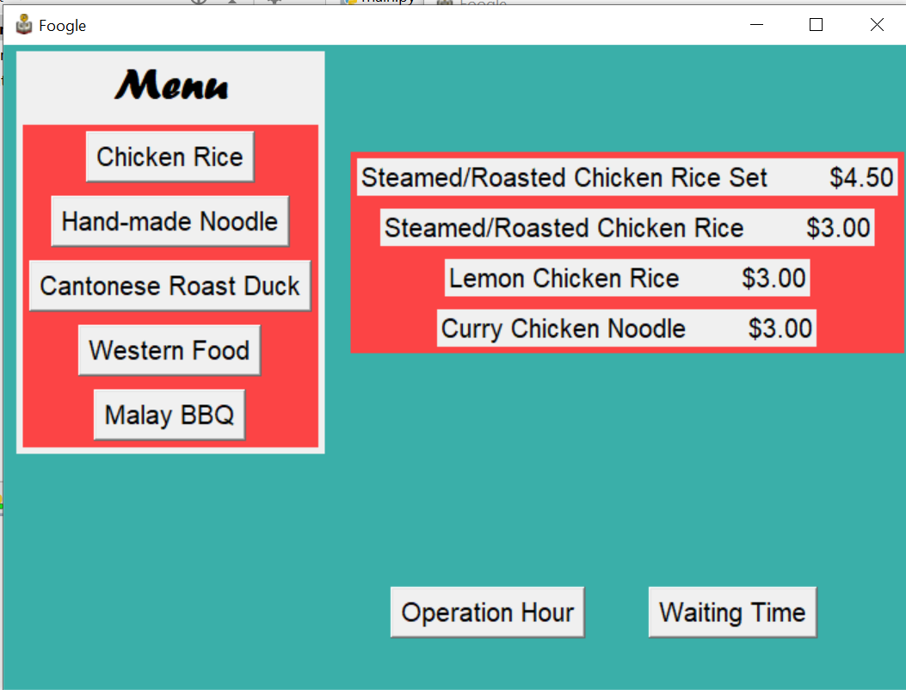

Slide 14
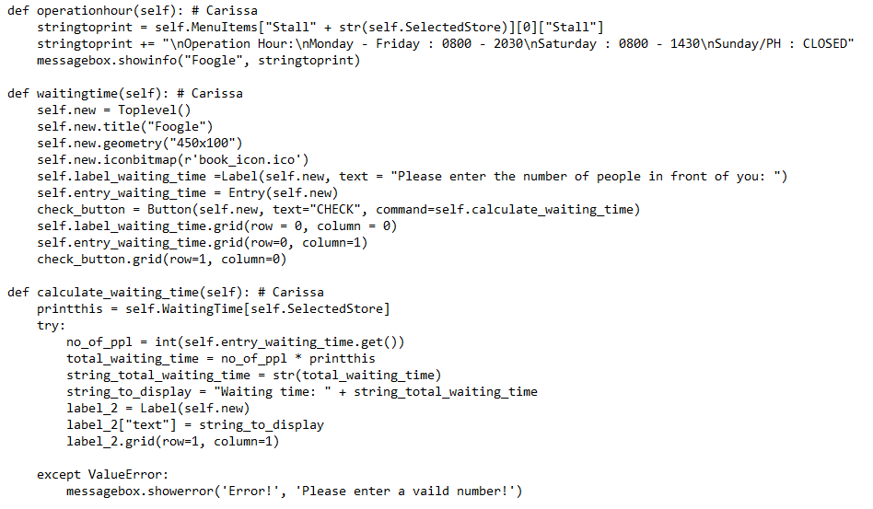
Operation hour, waiting time, calculate waiting time

Slide 15
Thank you!

